Slide 1
Final Project
Atharv Gopaluni

Slide 2

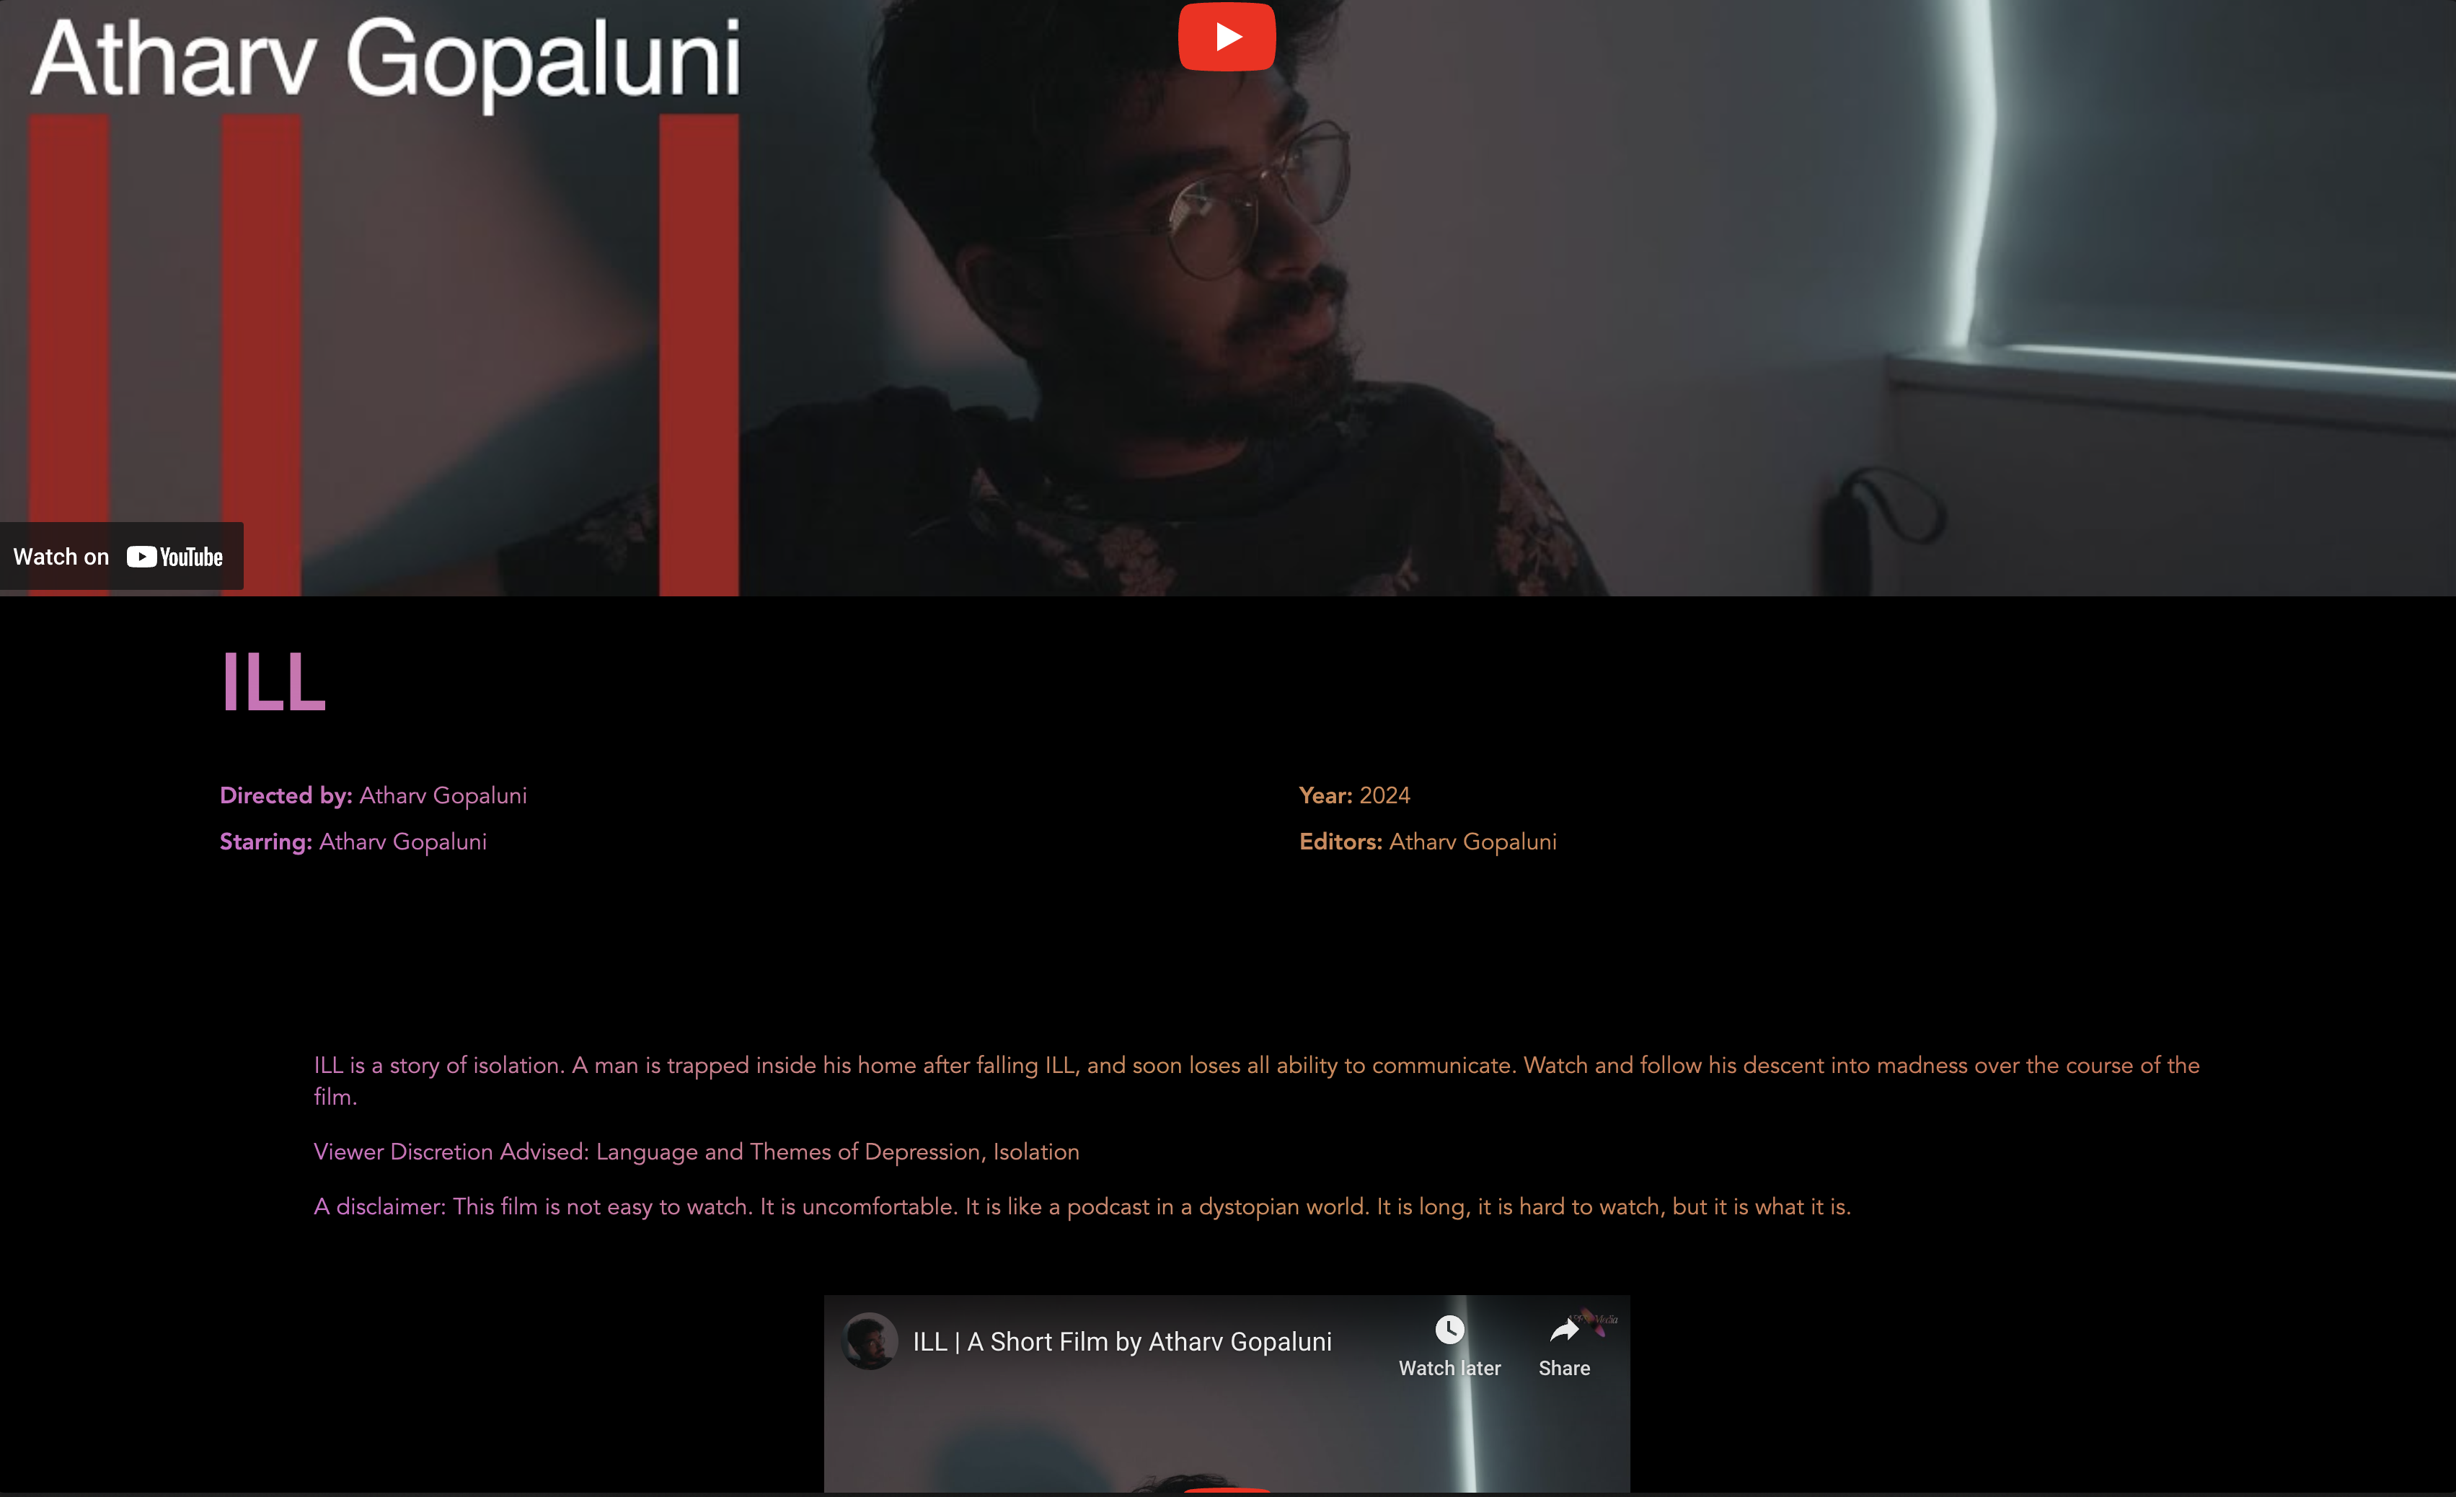

APEX Media Company Website – Demo
The website can be found at this address:
https://apexmediacompanywebsite.s3.us-east-2.amazonaws.com/home.html
Homepage
Film Highlight Page
Films Page

Slide 3



Original mockups

Slide 4
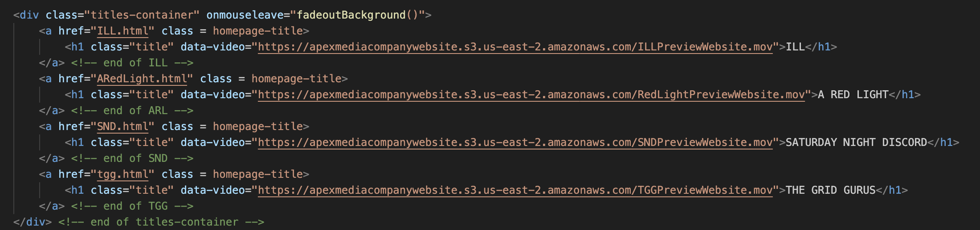
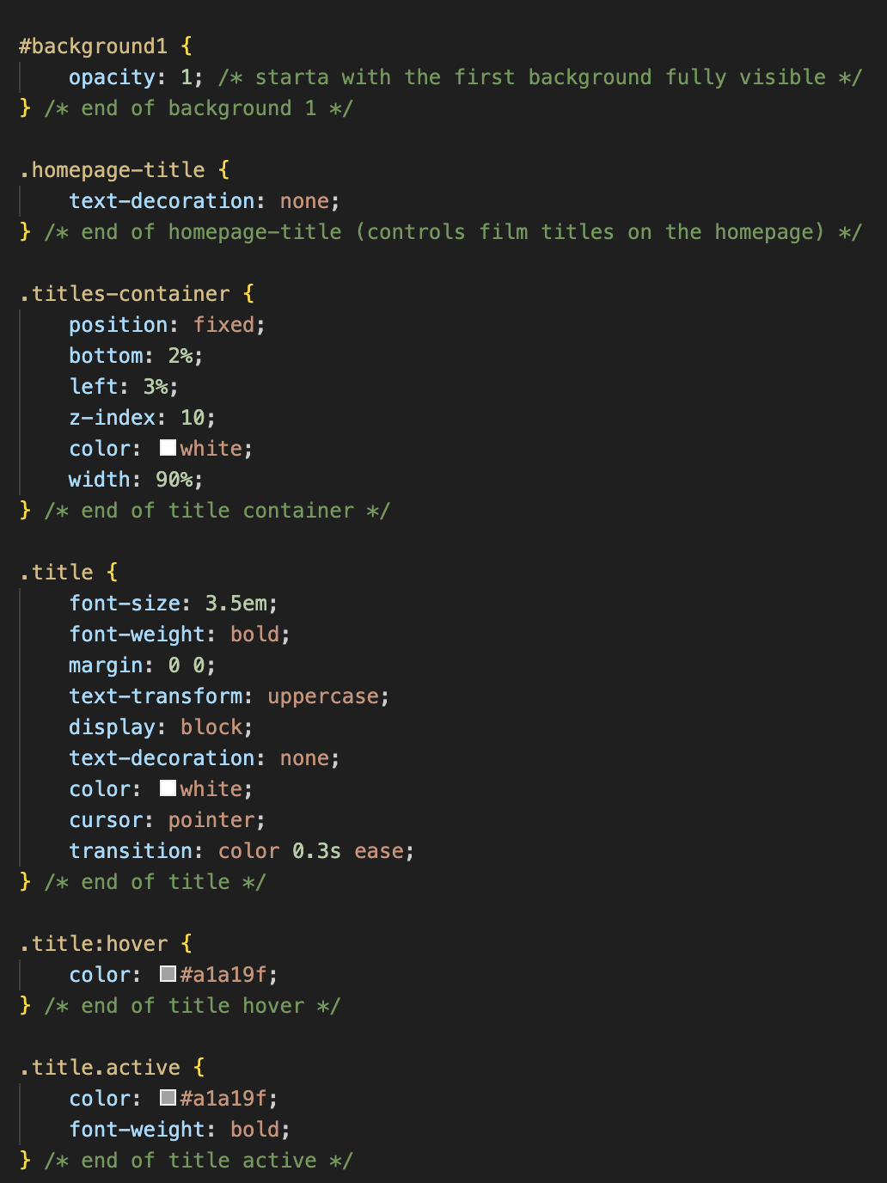
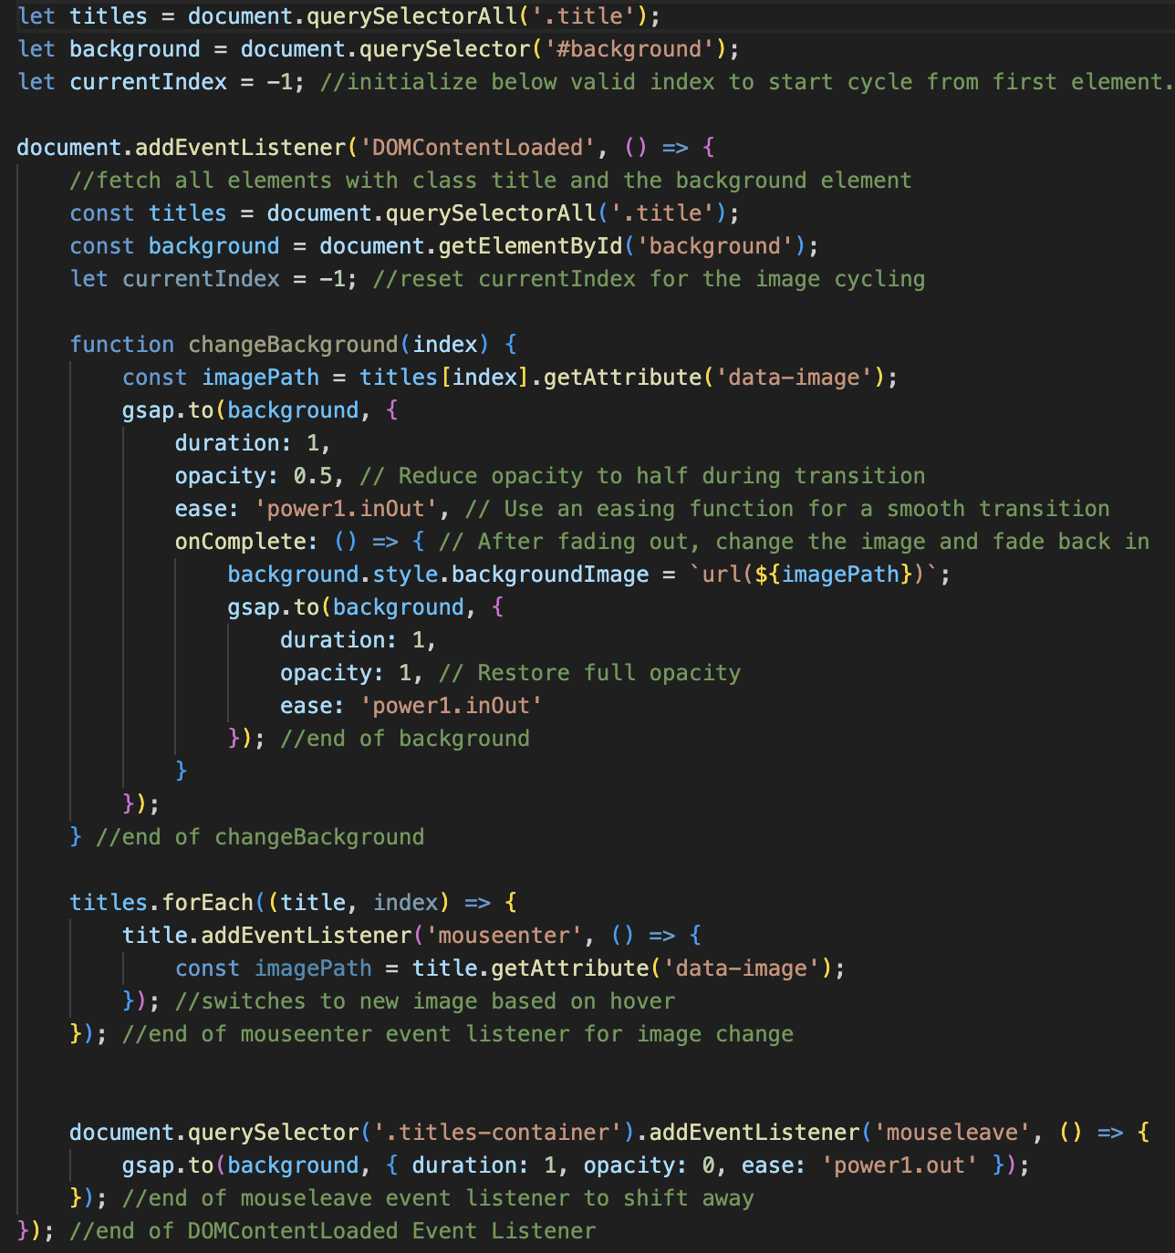
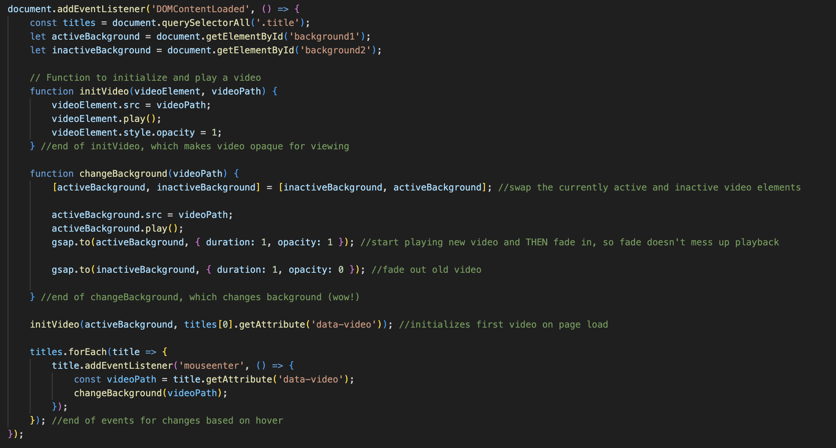
Code snippets
HTML Title Container on home page
Corresponding CSS
JavaScript for title page effect

Slide 5
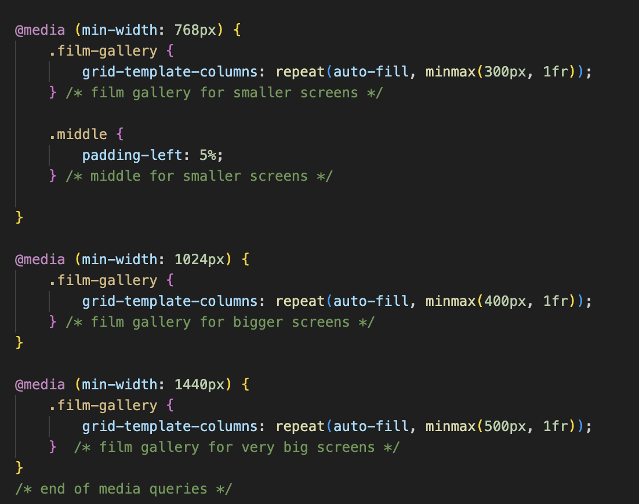
Media Queries

